Slide 1
Presentation on Diabetes Prediction
By Shubham Jain

Slide 2
PROBLEM STATEMENT
A hospital will conduct tests on various parameters of a person’s health information which can then be used by an expert to make conclusion whether the person is having diabetes or not.
In some regions of the country, there is lack of specialised doctors present, and this might create difficulties for people of the region to avail the preferred service. While getting tests results of various parameters can be done through machines, can the process of concluding/predicting whether a person has diabetes or not can also be done through machines? Will it have high accuracy so that the predictions will be reliable and can be used without an expert?

Slide 3
DATA WRANGLING
Dataset contains 2000 rows and 9 columns of data.
The columns data consists of health-related parameters of a person.
The columns are number of pregnancies occurred, glucose levels, blood pressure levels, skin thickness, BMI, DiabetesPedigreeFunction, age and outcome (whether the person has diabetes or not).
All independent columns are of numeric type.
The target column is of binary data type.

Slide 4
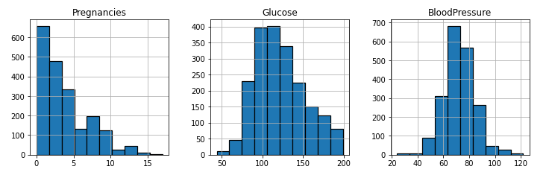
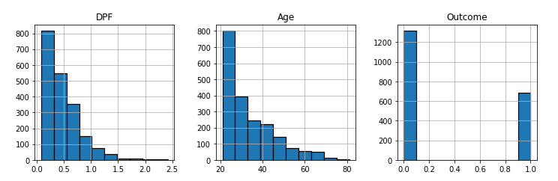
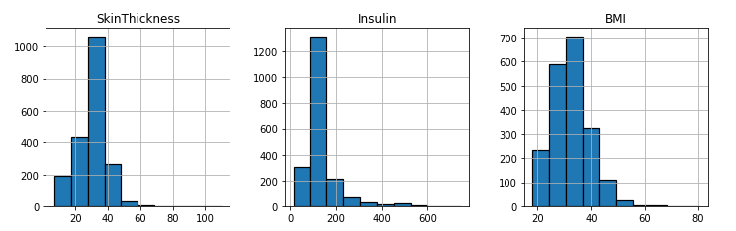
DATA DISTRIBUTION OF COLUMNS VIA HISTOGRAM

Slide 5
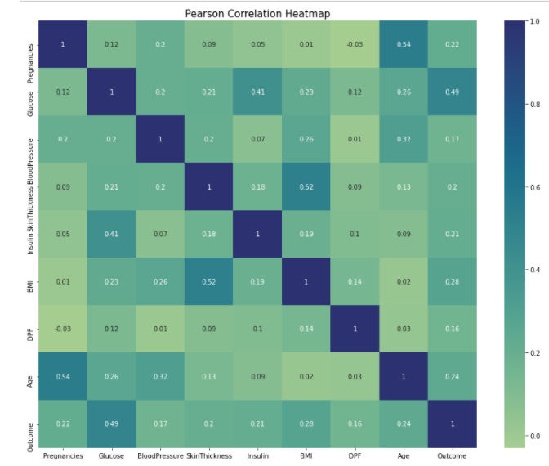
PEARSON CORRELATION HEATMAP
There is a good correlation between the glucose and outcome columns.
There is a fairly good correlation between the BMI and outcome columns.

Slide 6
PRE-PROCESSING AND TRAINING DATA DEVELOPMENT
The dataset was divided into training and test dataset in the ratio 75 is to 25.
Following are the split made in the dataset:
Training dataset with independent columns (75%)
Training dataset with dependent column (75%)
Test dataset with independent variables (25%)
Test dataset with dependent column (25%)
The training and test dataset of independent columns were standardized to remove any outlier cause and also to scale each feature/ variance to unit variance.

Slide 7
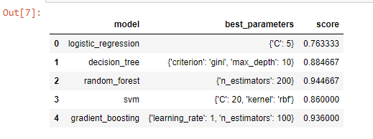
Model Evaluation and Optimization
Five models have been trained on the training dataset.
Few parameters tuning is done while training the models.
Random forest achieved the highest accuracy among all the models.
Performed hyperparameter tuning in the random forest model for getting better accuracy results.

Slide 8
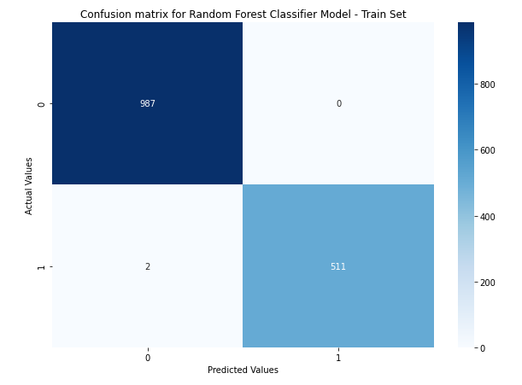
CONFUSION MATRIX ON TRAIN DATASET
99.8% accuracy achieved from the test dataset by tuning the model via hyperparameter optimization.

Slide 9
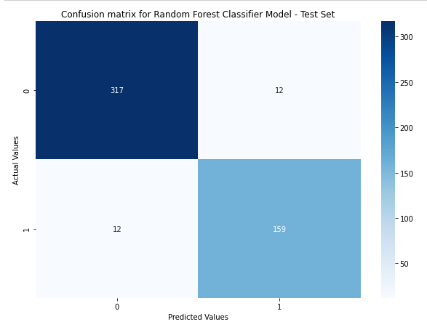
CONFUSION MATRIX ON TEST DATASET
96% accuracy achieved from the test dataset by tuning the model via hyperparameter optimization.

Slide 10
THANK-YOU!

